Slide 1
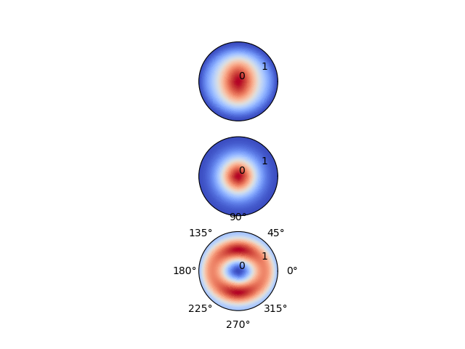

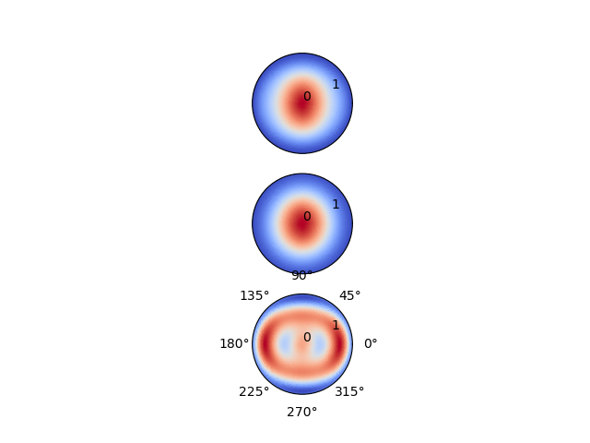

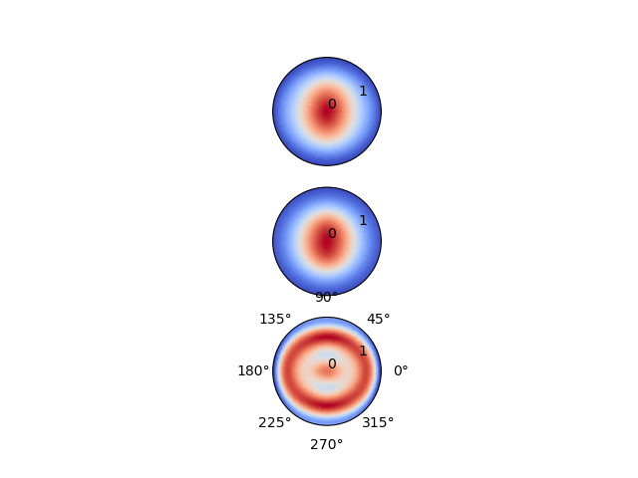


Rank0(1) Rank1(3) Rank2(6) Rank3(10) Rank4(15) Rank5(21) Rank6(28) Rank7(36)
Data
25MHz
Model
Residual
Percentage
Error
11.49%
11.49%
2.26%
2.26%
1.92%
1.92%
0.75%
0.75%

Slide 2
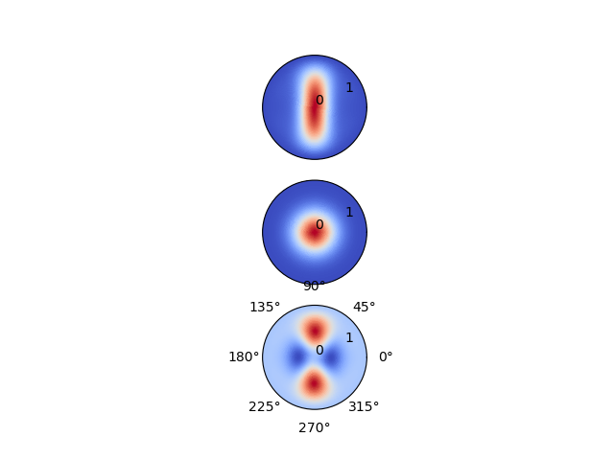

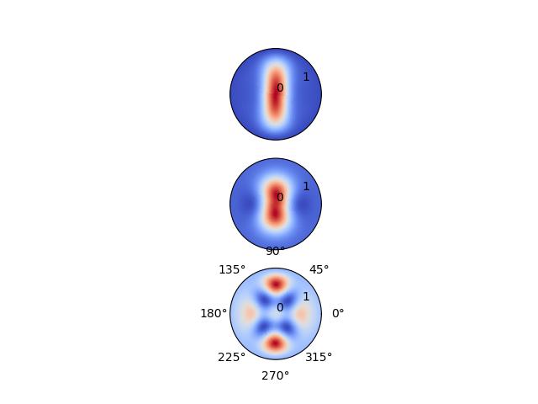




Rank0(1) Rank1(3) Rank2(6) Rank3(10) Rank4(15) Rank5(21) Rank6(28) Rank7(36)
Data
125 MHz
Model
Residual
Percentage
Error
16.77%
16.77%
5.87%
5.87%
1.32%
1.32%
0.86%
0.86%

Slide 3




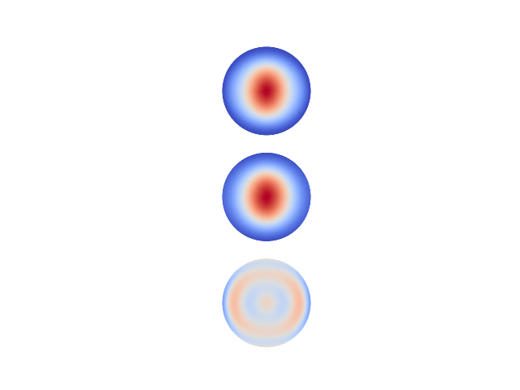

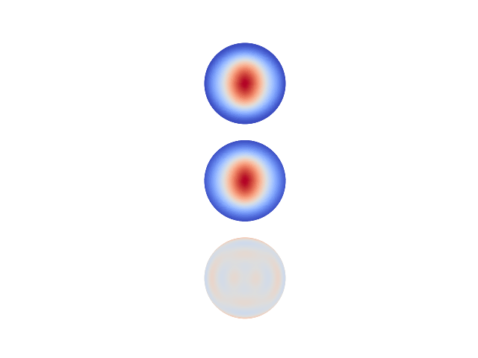

Rank0(1) Rank1(3) Rank2(6) Rank3(10) Rank4(15) Rank5(21) Rank6(28) Rank7(36)
Data
25MHz
Model
Residual
Percentage
Error
3.83%
3.83%
3.58%
3.58%
1.25%
1.25%
0.37%
0.37%

Slide 4
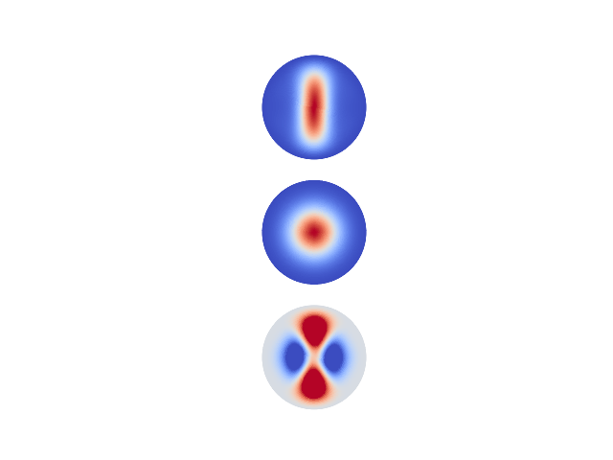

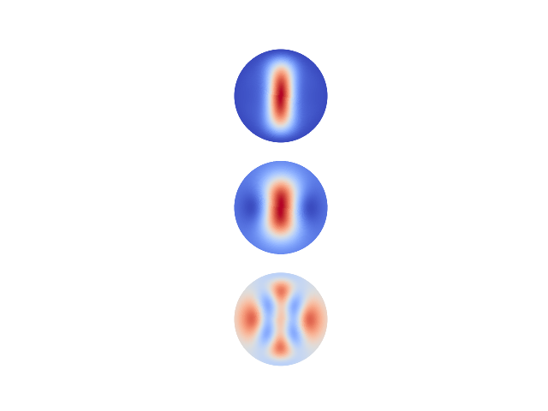





Rank0(1) Rank1(3) Rank2(6) Rank3(10) Rank4(15) Rank5(21) Rank6(28) Rank7(36)
Data
125MHz
Model
Residual
Percentage
Error
15.83%
15.83%
5.82%
5.82%
2.55%
2.55%
0.82%
0.82%

Slide 5
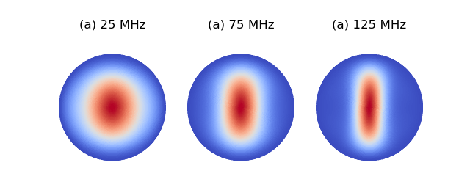

Slide 6

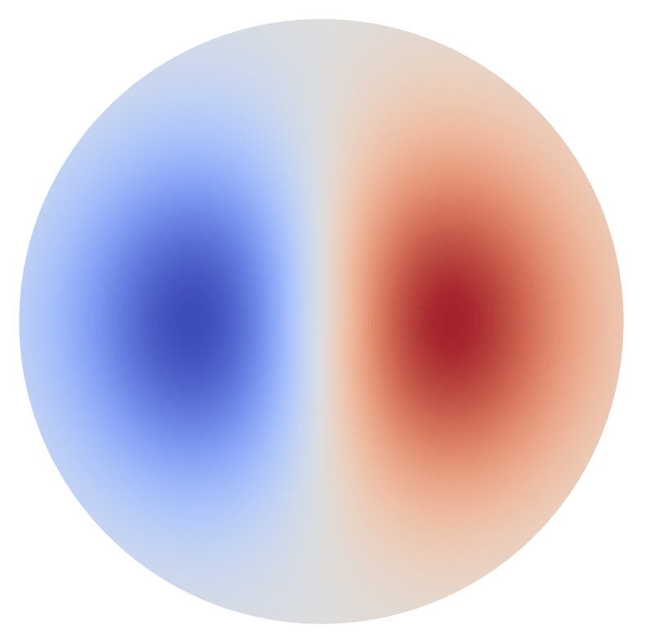
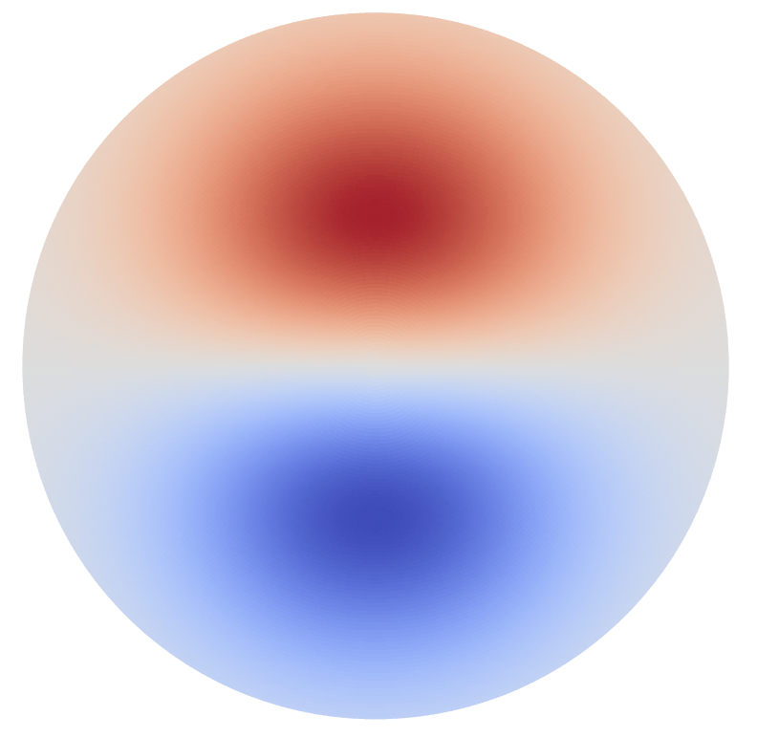

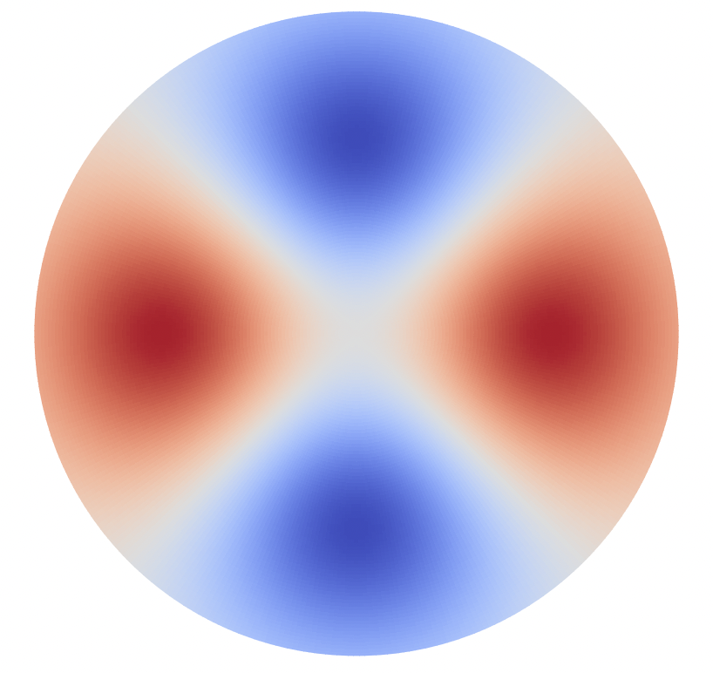
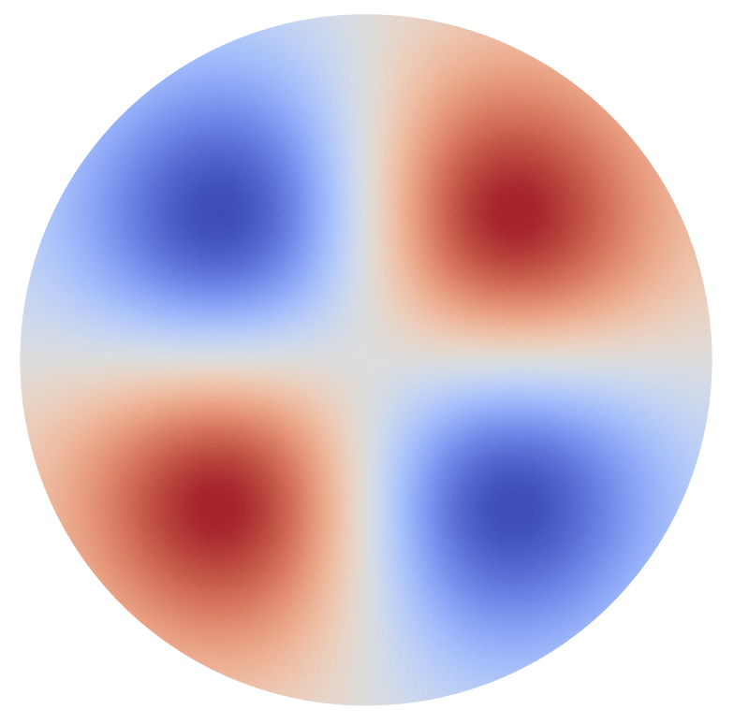
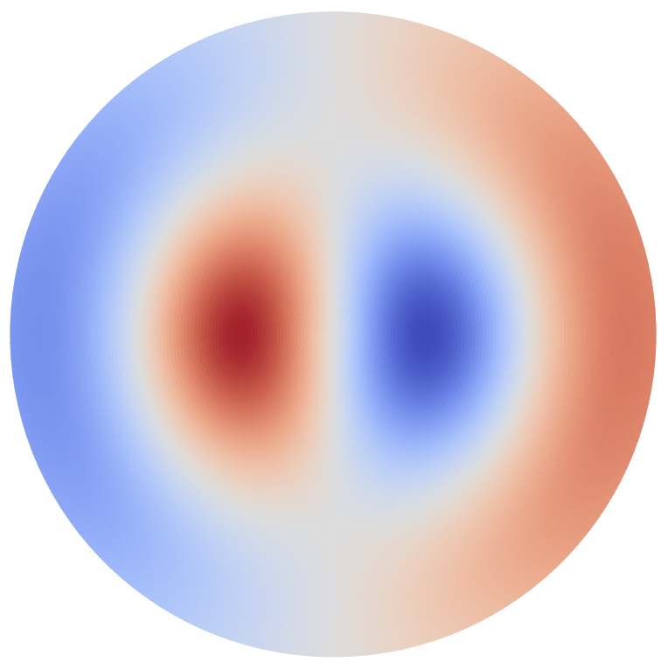
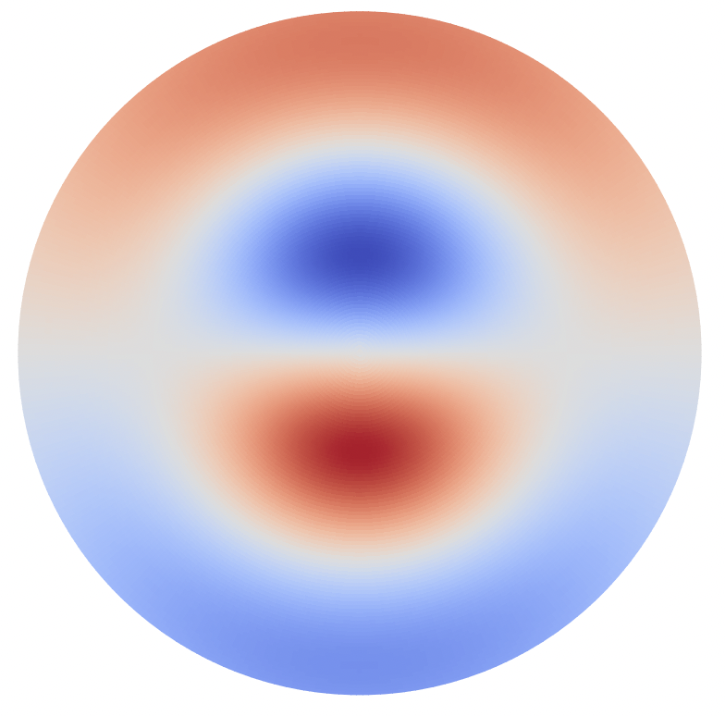
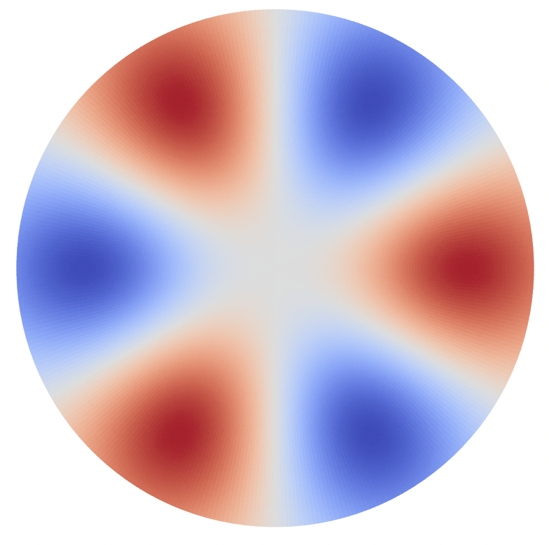
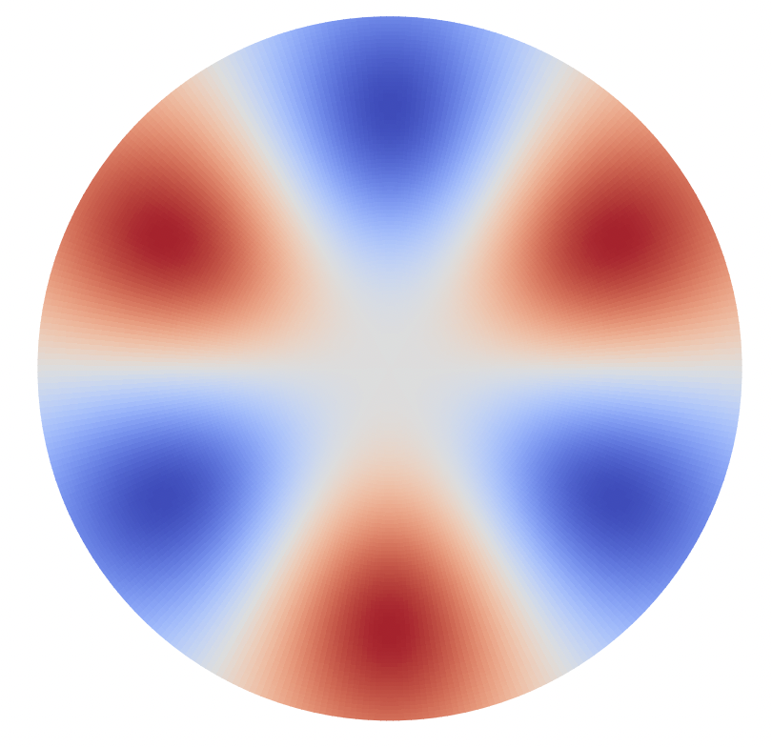

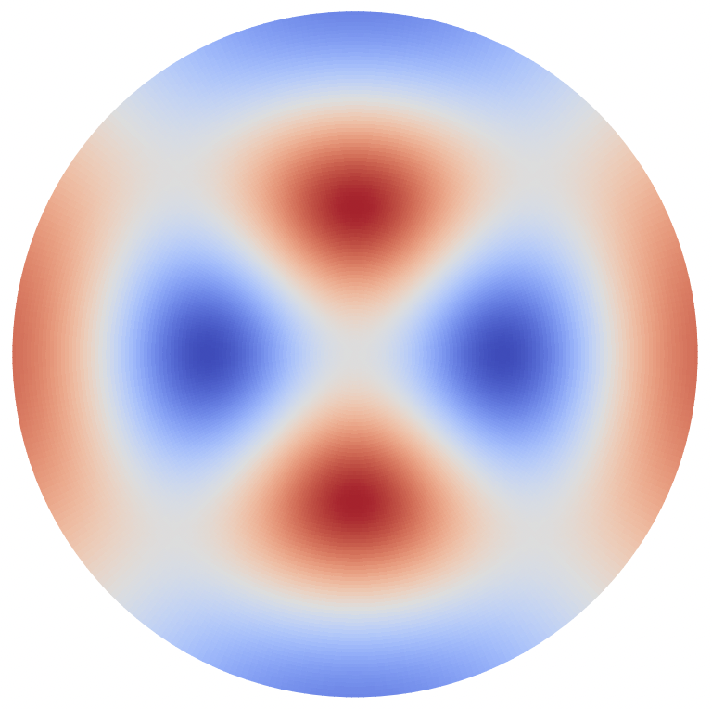
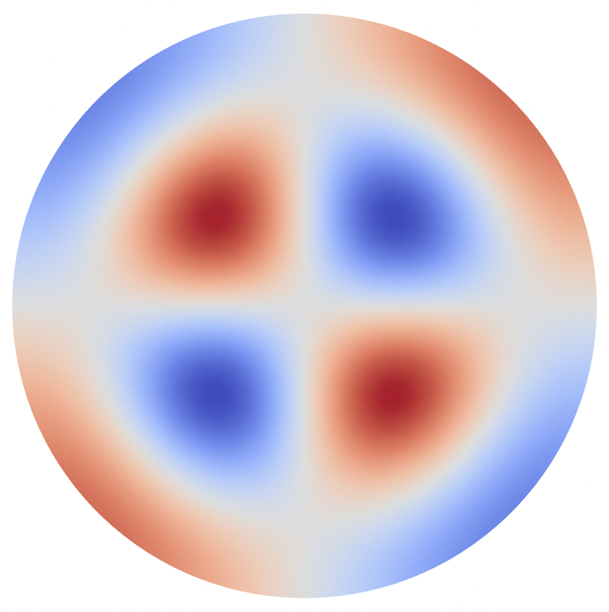
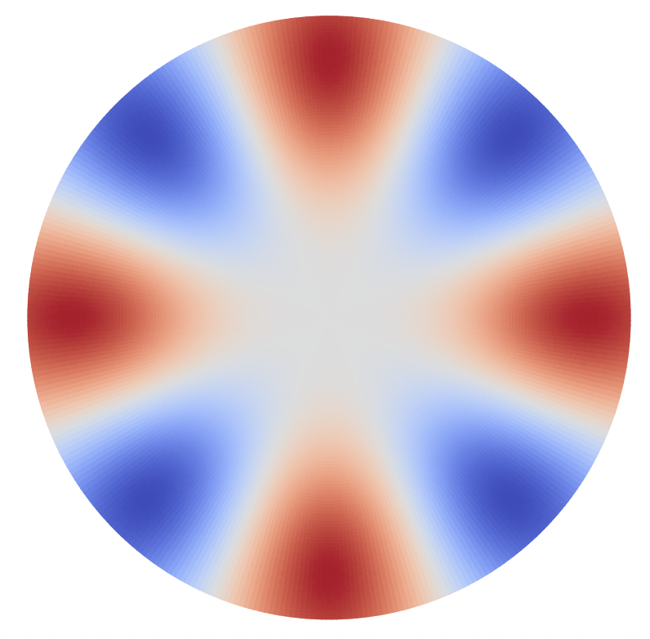
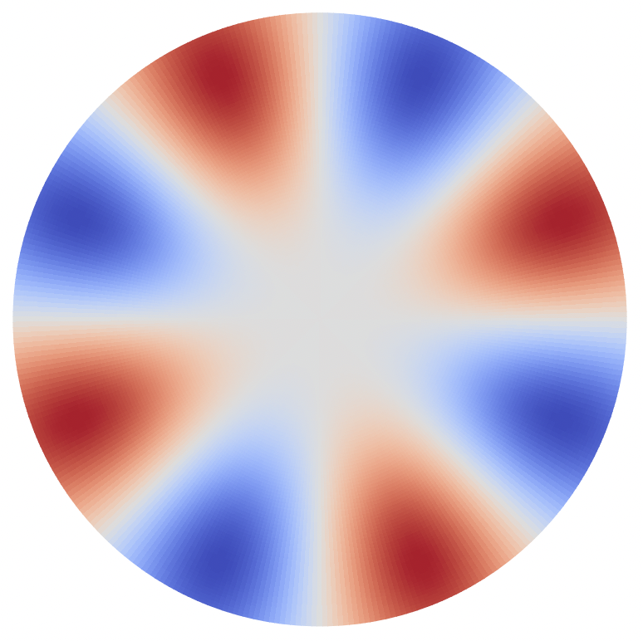
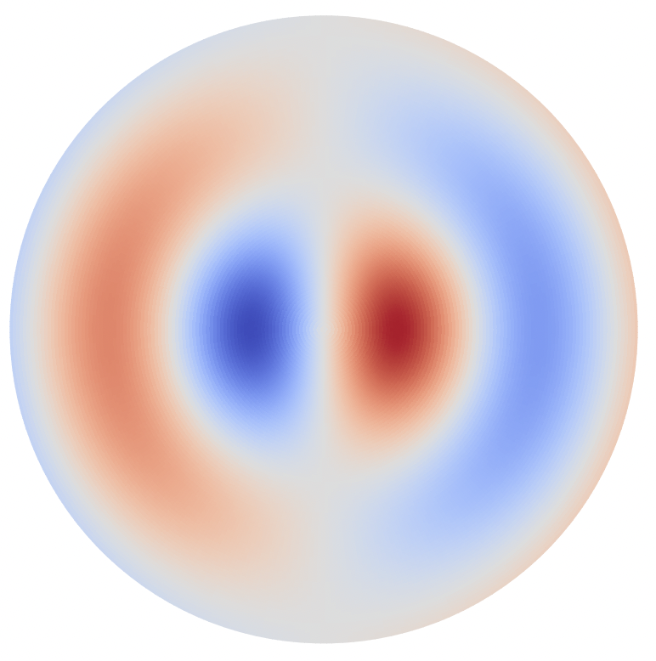
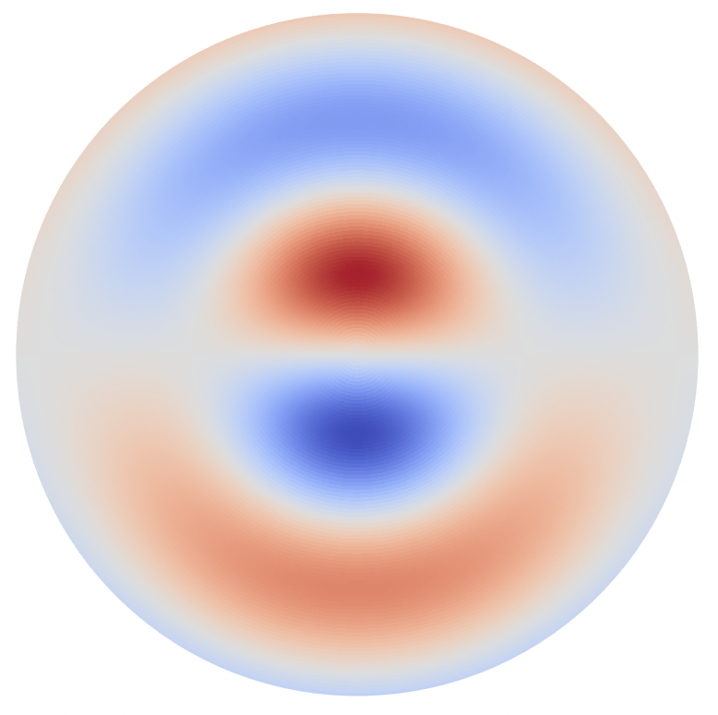
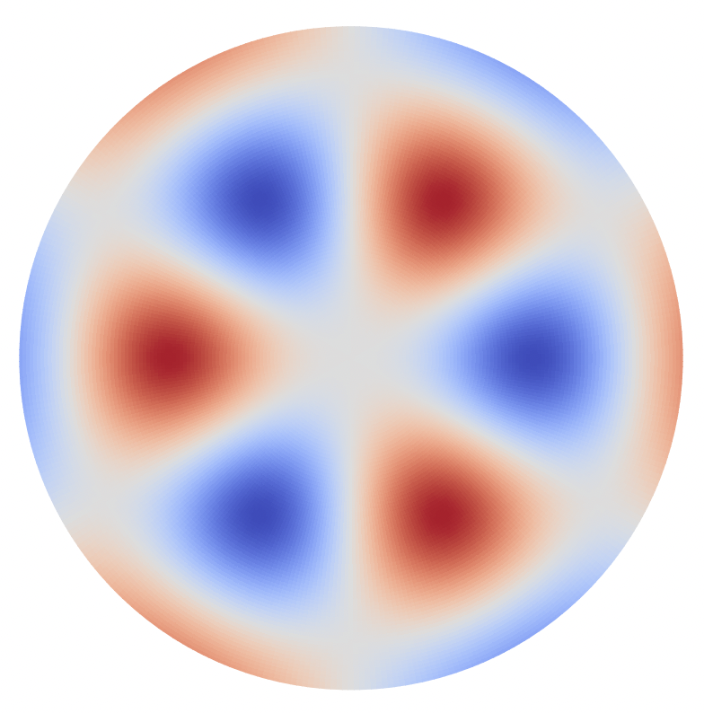
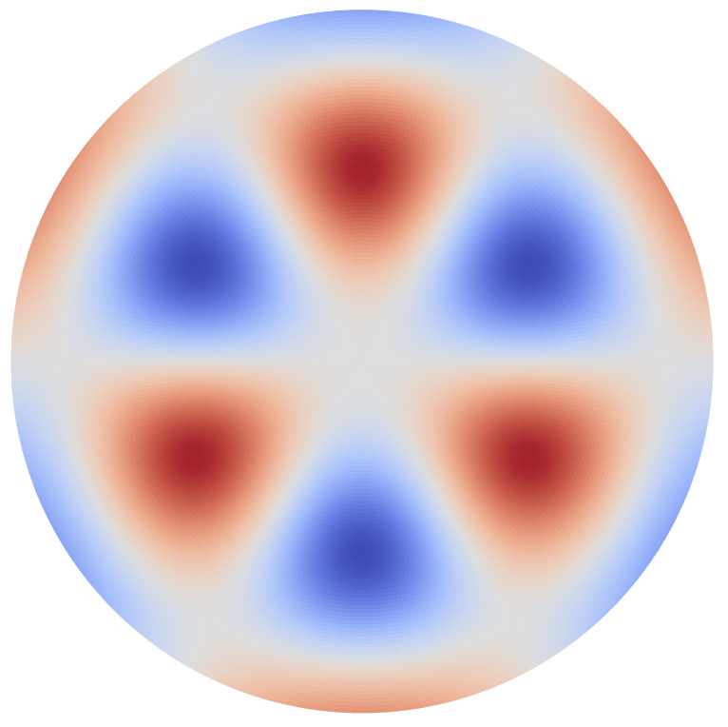

cos00 | cos10 | sin10 | cos01 | cos20 | sin20 | cos11 | sin11 | cos30 | sin30
3.83 | 63.56 | 63.56 | 51.17 | 63.55 | 63.55 | 63.56 | 63.56 | 63.56 | 63.56
59.73 | 0 | 0 | 12.39 | 0.012 | 0 | 0 | 0 | 0 | 0
25 MHz
The total: 63.56544624832476
cos02 | cos21 | sin21 | cos40 | sin40 | cos12 | sin12 | cos31 | sin31 | cos50
55.95 | 63.53 | 63.56 | 63.56 | 63.56 | 63.56 | 63.56 | 63.56 | 63.56 | 63.56
7.61 | 0.031 | 0 | 0 | 0 | 0 | 0 | 0 | 0 | 0

Slide 7
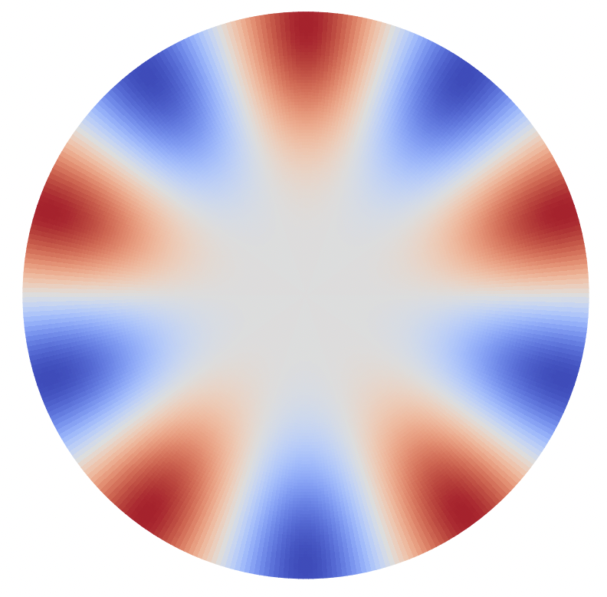

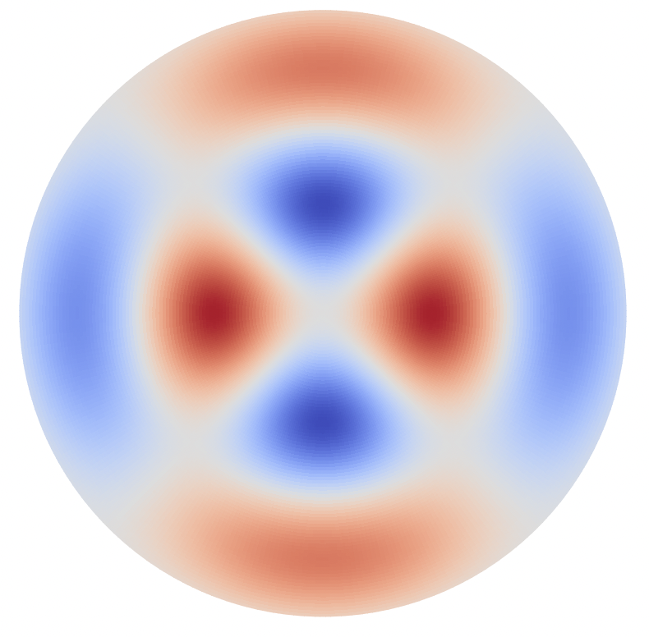
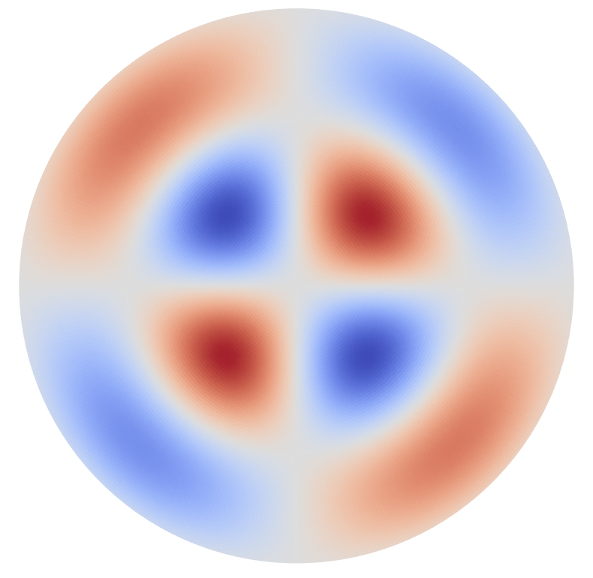
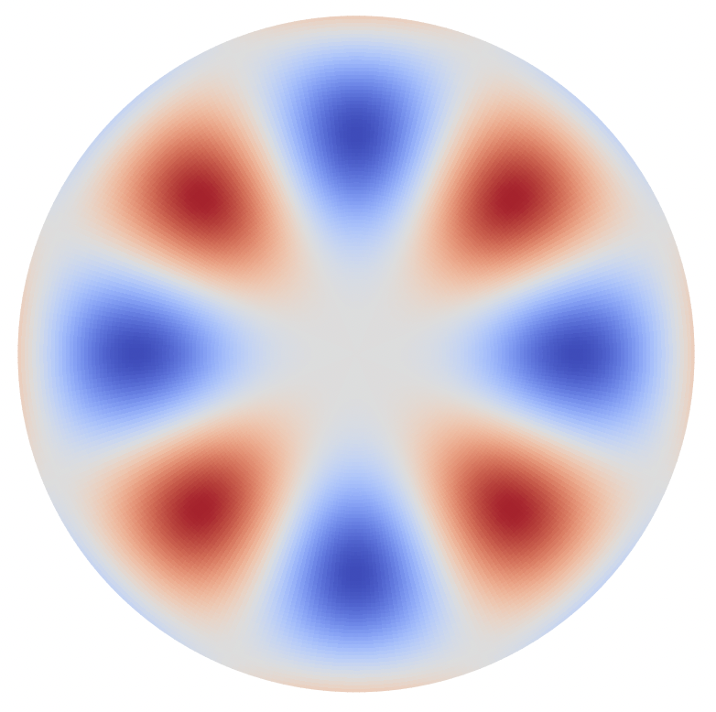
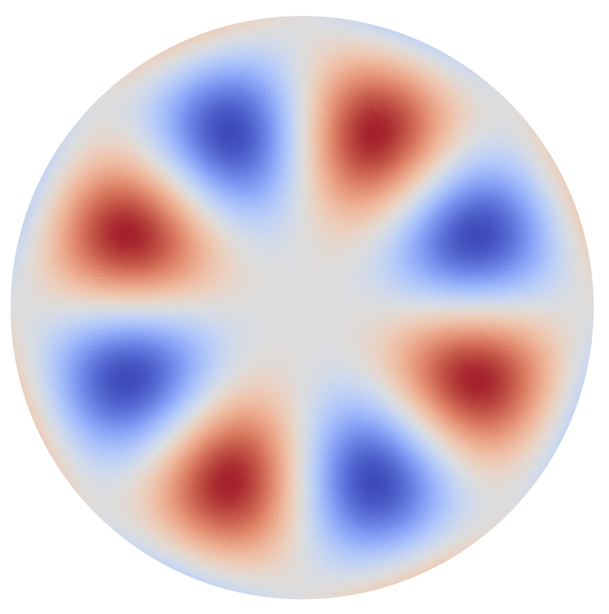


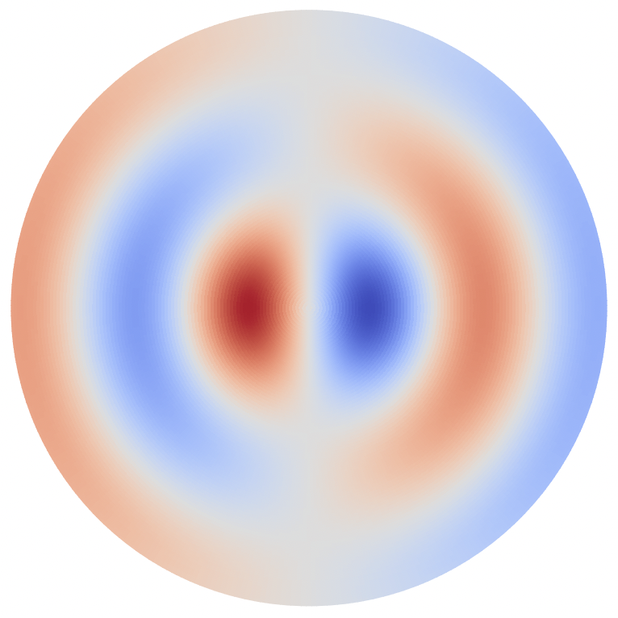
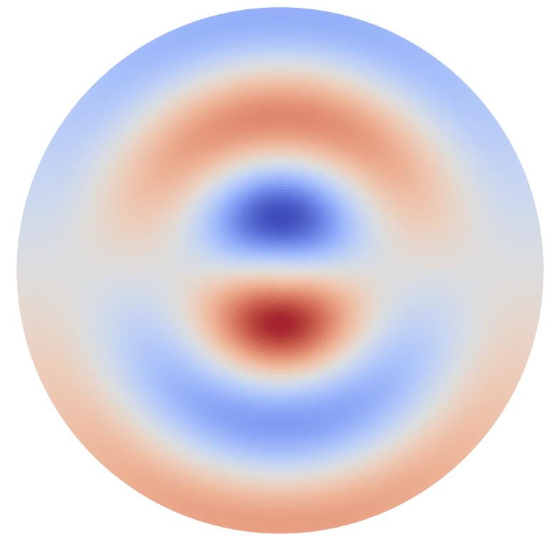
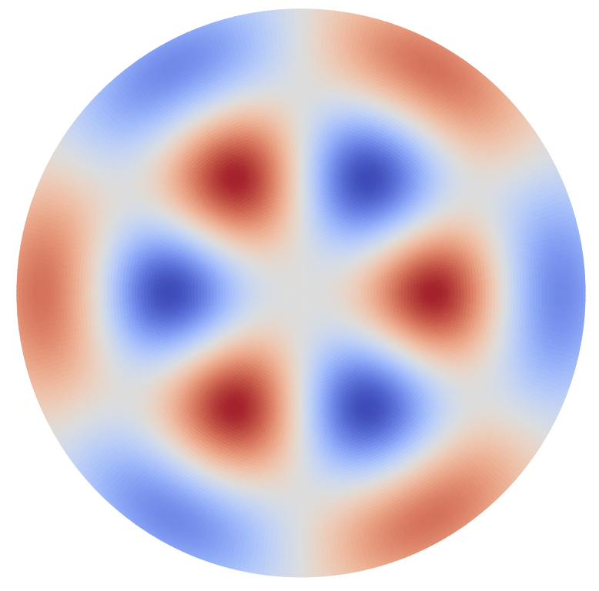
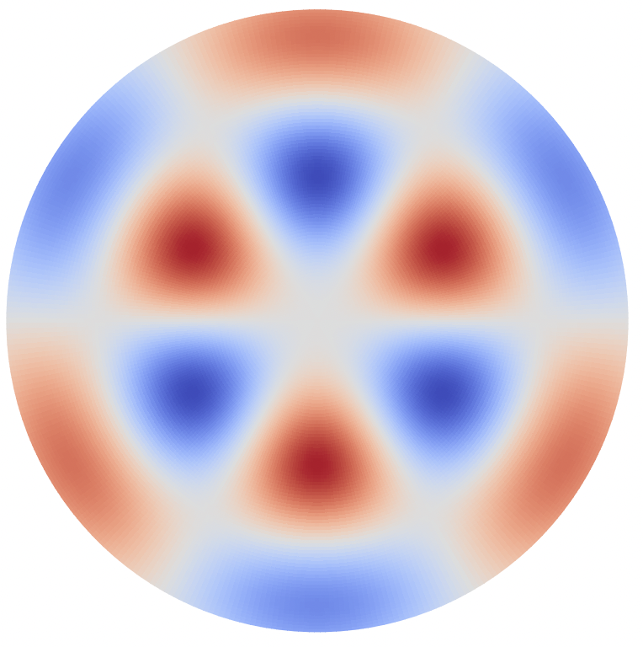
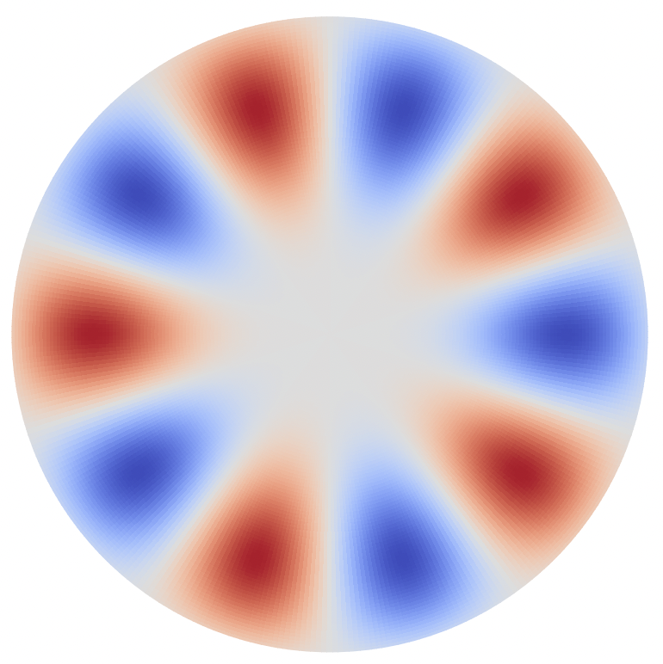
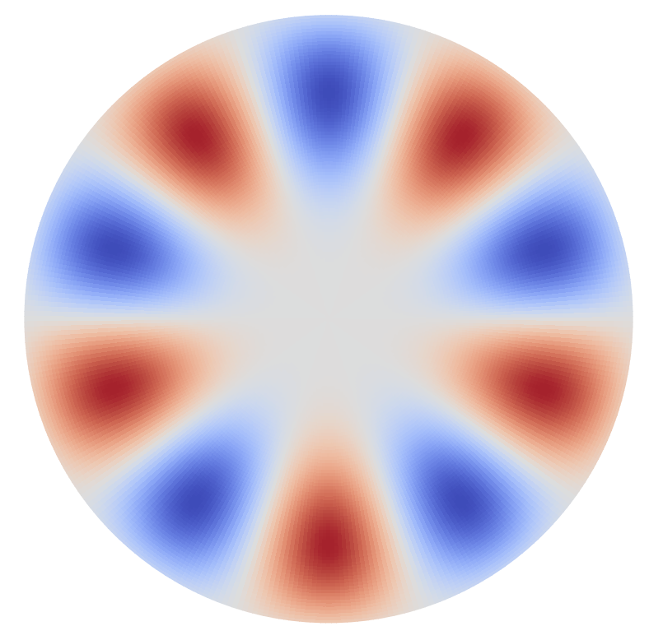


sin50 | cos03 | cos22 | sin22 | cos41 | sin41 | cos60 | sin60 | cos13 | sin13
63.56 | 57.36 | 63.54 | 63.56 | 63.56 | 63.55 | 63.56 | 63.56 | 63.56 | 63.56
0 | 6.21 | 0.025 | 0 | 0 | 0 | 0 | 0 | 0 | 0
25 MHz
The total: 63.56544624832476
cos32 | sin32 | cos51 | sin51 | cos70 | sin70
63.56 | 63.56 | 63.56 | 63.56 | 63.56 | 63.56
0 | 0 | 0 | 0 | 0 | 0

